Slide 1

Binary and computer logic
Lesson 5: Representing text

Slide 2
Objectives
In this lesson, you will learn:
how the ASCII system has standardised the way characters are represented
how to convert ASCII text into binary strings and vice versa.

Slide 3
The binary number system: a reminder
The binary system uses just two digits: 0 and 1.
A denary number can be represented by a binary number.
16s | 8s | 4s | 2s | 1s | Place values | Denary number
 |  |  |  | 1 | 1 × 1 | 1
 |  |  | 1 | 0 | 1 × 2 | 2
 |  | 1 | 1 | 1 | (1 × 4) + (1 × 2) + (1 × 1) | 7
 | 1 | 0 | 1 | 0 | (1 × 8) + (1 × 2) | 10
1 | 1 | 0 | 0 | 1 | (1 × 16) + (1 × 8) (1 × 1) | 25

Slide 4
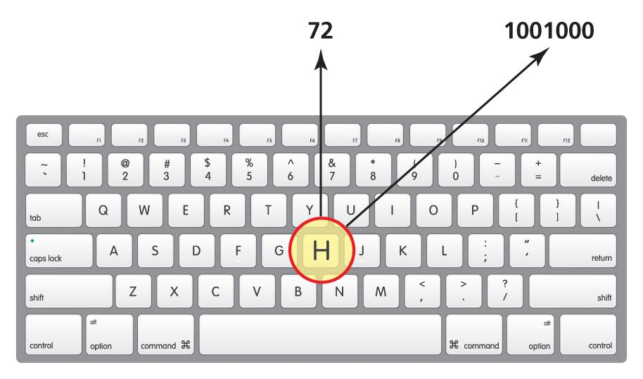
Processing characters
All the processing that takes place inside a computer is done using binary code, using 1s and 0s.
When you press a key on the keyboard, it uses a keyboard map to identify the character and return a binary code to the CPU.
The standard English alphabet characters, numbers and symbols are represented using seven bits. For example, H can be represented by 1001000.
Seven-bit binary code can be tricky for humans to work with, so we convert the binary numbers to denary. In this case, H can be represented by the denary number 72.

Slide 5
ASCII denary values
Standardisation is essential because we cannot assign the same denary number and binary string to two different characters if applications are to work on a range of different devices and on a global scale.
The American Standard Code for Information Interchange (ASCII) was invented to standardise the denary numbers assigned to each character on a keyboard.
Here are some characters and their ASCII denary values:
space | 32
! | 33
" | 34
# | 35
$ | 36
% | 37
@ | 64
A | 65
B | 66
C | 67
D | 68
E | 69
‘ | 96
a | 97
b | 98
c | 99
d | 100
e | 101

Slide 6
Converting a character to binary
The denary number we humans use to define a character is the equivalent of the 7-bit binary number the computer uses. So, 1000001 is the equivalent to 65 in denary, which we use to refer to the character A. Computers work with groups of 8 bits, so an additional 0 is added to the left of the binary number to make it a byte:
Letter | ASCII denary value | Binary value
A | 65 | 01000001

Slide 7
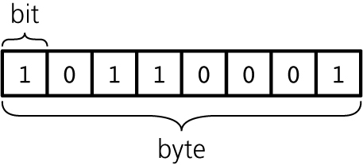
Bits and bytes
Each 1 and 0 in a binary number is knows as a bit.
The term ‘bit’ comes from the words ‘binary’ (involving two things) and ‘digit’ (a number from 0 to 9).
An 8-bit string of data is known as a byte of data. Computers process bytes.

Slide 8

Activity 5.1: ASCII converter

Slide 9
Activity 5.2: Processing a character like a computer (Part 1)

Slide 10
Activity 5.3: Processing a character like a computer (Part 2)

Slide 11
Activity 5.4: Hexadecimal

Slide 12
Unicode
ASCII can only represent 256 characters. This is because there are only 256 different ways 8 bits can be arranged into a byte.
This is adequate to represent characters when writing in English, but it is not adequate to represent all the characters in all the languages in the world.
This is why Unicode was developed. Each character is represented by 4 bytes, which means Unicode supports roughly 1,000,000 different characters.

Slide 13
Quiz 5

